Slide 1
WORKSHOP AD EXCHANGE 2016 FINAL DESIGN SPECIFICATION DOCUMENT
TOP-3
YUVAL ZUARETZ, NOAM DVIR, EYAL AGIV

Slide 2
INTRODUCTION
A straight forward implementation for this project is to divide it to 2 main modules, for each module can operate separately to the others
Campaign Bidder
UCS Bidder
Bid Bundle
“Simple is better”- we tried to make the first algorithm quit simple, and then iterate on it-
We assume this will be easier to find out where we need to put our focus on
Lot of automation and log parsing in order to make these iteration more efficient

Slide 3
AGENT LIGHTHOUSE
Efficiency
identify campaigns with highest potential
minimizing our expenses at times our agent is less active
aggressive competitions against other agents lead to high expenses and smaller profit
Maintain high score-
high quality rating is crucial
Utilizing Randomness-
Random allocated campaign portion is high- utilise this!

Slide 4
CAMPAIGN BIDDER
This module role is to win campaign with a price that will leave us with a profit
The data we can collect and use in this section in:
Current active campaign
Our Previos Campaign bids
Current quality rate
Our final implementation depend very much on the randomness of the game

Slide 5
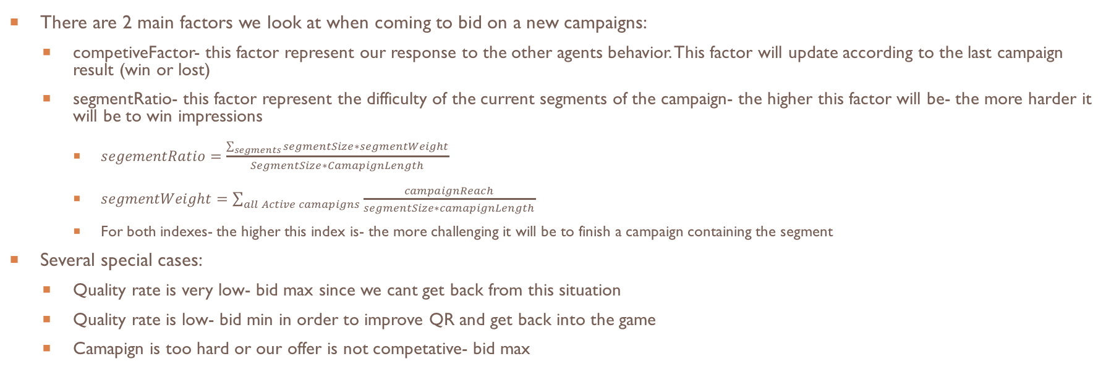
CAMPAIGN BIDDER- CONT.

Slide 6
CAMPAIGN BIDDER INSIGHTS
In our previous implementation we tried to predict the next Campaign bid from database containing all previous campaign opportunities
This turned out to be not good enough due to the e that the game is highly dynamic
There is not enough data we can collect and use
Our first impression that said more campaign leads to more profit turned out to be wrong
The bidding war between the agents often lead to a low final bid

Slide 7
UCS BIDDER:
General guidelines:
Maintain a decent rate throughout the game
Save where we can
Use yesterday’s info to determine today’s bid

Slide 8
UCS BIDDER:
Initial Idea:
1st: bid less
2nd: bid same
3rd: bid same
4th&5th: bid more (if need, otherwise bid same)
6th: bid more

Slide 9
UCS BIDDER:
But we can do better!
(or can we?)

Slide 10
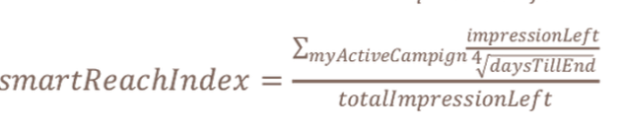
UCS BIDDER:

Slide 11
UCS BIDDER:
New Idea:
Evaluate current targeted level, using smartReachIndex
Compare it to yesterday's actual UCS result
Compare it to yesterday's targeted value

Slide 12
BID BUNDLE
This class is responsible for determine bids on impression opportunities – known as bid-bundle
Contains a main function SendBidsAndAds that heavily extends the functionality of the basic one given. This func construct the BidBundle object that send to the server.
Contains also an auxiliary function that checks if given campaign is active

Slide 13
BID BUNDLE
The strategy determine what part of the budget will be allocated to which impression opportunities
To do so, we sort the campaigns according to the segment
Going through the segments, and weight campaigns.
The weight of campaign in a segment is the part of impressions to finish of all campaigns in the segment.

Slide 14
BID BUNDLE
For every query of every active campaign, we calculate the percent of the total budget to bid.
We distinguish between different types of situations, and use different ratio multilayer (parameters) that we tested different values to get to the current optimal results

Slide 15
BID BUNDLE - SITUATIONS
First days (5) – known to be important for quality ratio, other players play aggressively on start, and we do too, as we have to match.
Short campaigns – we notice that if you don't start good on short campaigns you'll have hard time to complete them, so we start hard.
We calculate difficulty for campaigns, and note “difficult” campaigns to bid more in order to complete.
Classic campaigns – non short/difficult/first days campaigns

Slide 16
BID BUNDLE - PANIC
While situations are good planning, we still need to react when things not going so well, so for every situations we note when it's not going well and act to finish.
Panic levels are different for different situations, and Panic rate is calculated as the ratio between needed ratio impressions to complete campaign and the ration given by plan
When panic we mult the budget and add weight so we bid more and have a chance to complete the campaign

Slide 17
BID BUNDLE
After that, we check if the query is mobile or video, and multiply at mobileCoef / videoCoef accordingly (can have both)
Sending the BidBundle object - as constructed by the function described above

Slide 18
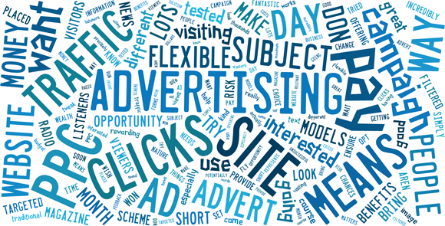
THE END

